Slide 1
Instagram User Analytics REPORT
Yuganter Pratap

Slide 2
Project Description
User analytics is the process by which we track how users interact with our digital products (software or mobile apps) and try to enable business, product and development teams to engage. Teams across the company then use these insights to create new marketing plans, decide on features to develop for the app, track app success by measuring user engagement, and improve experience while helping business grow.

Slide 3
Approach
In approaching the project where I utilized a dataset to conduct analysis using SQL, my primary focus was on ensuring a systematic and thorough methodology. I began by carefully understanding the dataset, its structure, and the specific objectives of the analysis. This enabled me to formulate insightful questions and hypotheses to guide my exploration. Next, I designed an organized SQL workflow, leveraging the appropriate queries, joins, and aggregations to extract meaningful insights from the dataset. Throughout the process, I maintained a meticulous approach, double-checking my code and results for accuracy. Overall, my approach combined a strong understanding of the dataset, meticulous SQL coding, and a focus on producing valuable insights that aligned with the project's objectives.

Slide 4



TECh-stack used
MYSQL WORKBENCH
FOR QUERIES
MICROSOFT VSCODE,
EXCEL FOR STORAGE
PYTHON MATPLOTLIB
FOR VISUALS

Slide 5
Insights on Marketing
Rewarding Most Loyal Users
id | username | created_at
80 | Darby_Herzog | 06-05-2016 00:14
67 | Emilio_Bernier52 | 06-05-2016 13:04
63 | Elenor88 | 08-05-2016 01:30
95 | Nicole71 | 09-05-2016 17:30
38 | Jordyn.Jacobson2 | 14-05-2016 07:56
SQL QUERY :-
select *
from users
order by created_at asc;
Understand
It was observed that a notable group of individuals has been active on the platform since its early days, demonstrating remarkable loyalty and longevity.

Slide 6
Insights on Marketing
Remind Inactive Users to Start Posting
id | username | created_at
5 | Aniya_Hackett | 07-12-2016 01:04
7 | Kasandra_Homenick | 12-12-2016 06:50
14 | Jaclyn81 | 06-02-2017 23:29
21 | Rocio33 | 23-01-2017 11:51
24 | Maxwell.Halvorson | 18-04-2017 02:32
25 | Tierra.Trantow | 03-10-2016 12:49
34 | Pearl7 | 08-07-2016 21:42
36 | Ollie_Ledner37 | 04-08-2016 15:42
41 | Mckenna17 | 17-07-2016 17:25
45 | David.Osinski47 | 05-02-2017 21:23
49 | Morgan.Kassulke | 30-10-2016 12:42
53 | Linnea59 | 07-02-2017 07:49
54 | Duane60 | 21-12-2016 04:43
57 | Julien_Schmidt | 02-02-2017 23:12
66 | Mike.Auer39 | 01-07-2016 17:36
68 | Franco_Keebler64 | 13-11-2016 20:09
71 | Nia_Haag | 14-05-2016 15:38
74 | Hulda.Macejkovic | 25-01-2017 17:17
75 | Leslie67 | 21-09-2016 05:14
76 | Janelle.Nikolaus81 | 21-07-2016 09:26
80 | Darby_Herzog | 06-05-2016 00:14
81 | Esther.Zulauf61 | 14-01-2017 17:02
83 | Bartholome.Bernhard | 06-11-2016 02:31
89 | Jessyca_West | 14-09-2016 23:47
90 | Esmeralda.Mraz57 | 03-03-2017 11:52
91 | Bethany20 | 03-06-2016 23:31
SQL QUERY :-
select * from users as u
left join photos as p
on u.id = p.user_id where image_url is Null;
It appears that a considerable portion of users either prefer to consume content rather than create it, or they may be using the platform solely for other purposes, such as following influencers or staying updated on trends.

Slide 7
Insights on Marketing
Declaring Contest Winner
 | Username | photo_id | Likes
 | Zack_Kemmer93 | 145 | 48
SQL QUERY :-
select u.username, l.photo_id,COUNT(*) as likes
from photos as p
join likes as l
on p.id = l.photo_id
join users u
on u.id = p.user_id
where p.id = 145 Group by l.photo_id order by COUNT(*) desc;
Understand
The winner of the contest with the most likes at 48

Slide 8
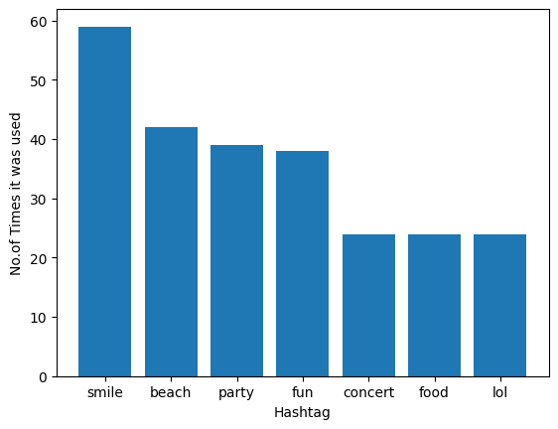
Insights on Marketing
Hashtag Researching
SQL QUERY :-
SELECT t.tag_name,
p.tag_id,
COUNT(*)
from tags as t
join photo_tags as p
on t.id = p.tag_id
GROUP BY t.tag_name,p.tag_id order by COUNT(*) desc;
The top 5 most used hashtags on the platform, with 3 hashtags tied for the 5th position. It is observed that positive and radiant hashtags are used the most on the platform.

Slide 9
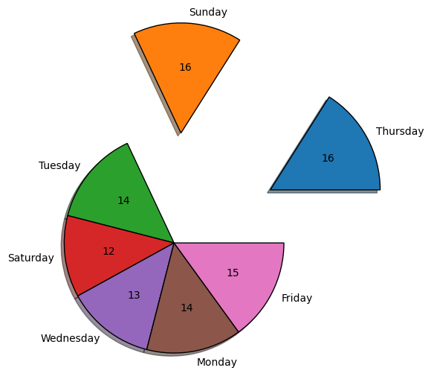
Insights on Marketing
Launch AD Campaign
SQL QUERY :-
SELECT DAYNAME(created_at) as week, COUNT(*)
FROM users
GROUP BY week;
Most accounts were made either on Thursdays or Sundays. These days may hold some significance or offer favorable conditions for account creation. This finding sheds light on the underlying patterns and user behaviors associated with joining the platform

Slide 10
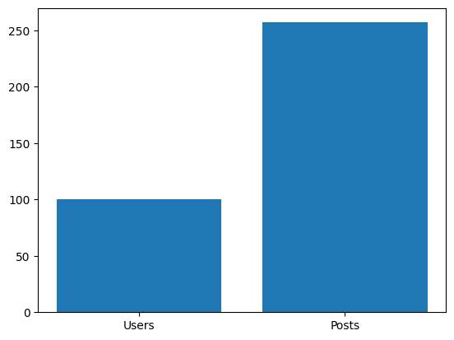
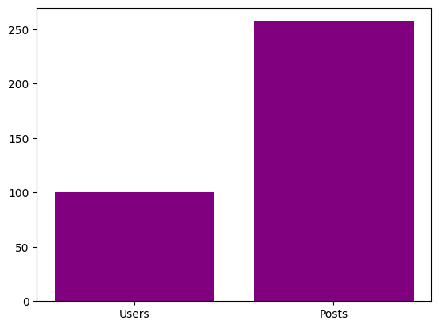
Insights on Investor Metrics
User Engagement
In total :-
The platform has 100 users and 257 Photos
An average user posts on Instagram 2.57 times
SQL QUERY :-
select count(*) from users
select count(*) from photos
select (max(p.id)/max(u.id)) as average
from users u
join
photos p
on u.id = p.user_id

Slide 11
Insights on Investor Metrics
Bots & Fake Accounts
Since we know the platform has 257 posts. If an account has liked all these posts, he would be a Bot/Fake Account.
user_id | username | Posts_Liked
5 | Aniya_Hackett | 257
14 | Jaclyn81 | 257
21 | Rocio33 | 257
24 | Maxwell.Halvorson | 257
36 | Ollie_Ledner37 | 257
41 | Mckenna17 | 257
54 | Duane60 | 257
57 | Julien_Schmidt | 257
66 | Mike.Auer39 | 257
71 | Nia_Haag | 257
75 | Leslie67 | 257
76 | Janelle.Nikolaus81 | 257
91 | Bethany20 | 257
SQL QUERY :-
select l.user_id, u.username, COUNT(*) as Posts_Liked
from users u
join likes l
on l.user_id = u.id
group by l.user_id HAVING COUNT(*) = 257

Slide 12
Thank You
Yuganter Pratap
vanshthakur0425@gmail.com

